Slide 1
Sentiment analysis for Movie Review Data with Natural Language Processing.

Slide 2
TOPIC:
The intention of this project is to build two classifiers and compare their performance in sentiment analysis and classifying the given movie reviews dataset as positive and negative reviews.
In order to achieve this goal, we use Natural Language Processing, where we will make the computer truly understand more than just the objective definitions of the words.

Slide 3
DATASET: DATA PRE-PROCESSING
This step involves cleaning the dataset such as removing unwanted characters (-, –, # and $), html tags or stopwords that don’t add much value, and replace them with blank spaces. Steps included are:
Removing html strips and noise text.
Removing special characters.
Text stemming.
Removing stopwords.

Slide 4
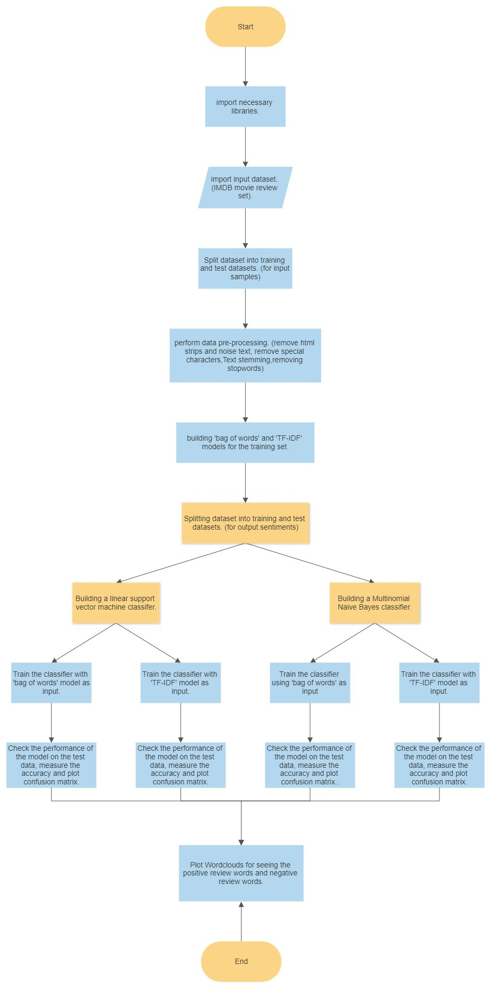
FLOWCHART:

Slide 5
(contd.)

Slide 6
ALGORITHMS USED: TEXT-FILTERING TECHNIQUES (i)
BAG OF WORDS:
This method analyzes the entire corpus of text, builds a dictionary of all words, and translates every instance in the dataset into a list of numbers, counting how many times each word appears in the document.

Slide 7
TEXT-FILTERING TECHNIQUES (ii):
TDF/IF MODEL:
TDF-IF normalizes the word counts based on the frequency of how often each word appears across the documents. The main idea is that common words get smaller weighting factors, and relatively rare words get larger weighting factors, which enables you to dig deeper into the (often highly informative) words that appear less often in the dataset.

Slide 8
CLASSIFIERS USED (i):
NAIVE BAYES (NB):
Naive Bayes is based on Bayes’ theorem, where the adjective Naïve says that features in the dataset are mutually independent. Occurrence of one feature does not affect the probability of occurrence of the other feature. The multinomial Naive Bayes classifier is suitable for classification with discrete features (e.g. word counts for text classification).
Notes:
Multinomial Naïve Bayes consider a feature vector where a given term represents the number of times it appears or very often i.e. frequency.

Slide 9
CLASSIFIERS USED (Ii):
SUPPORT VECTOR MACHINE (SVM):
A Support Vector Machine (SVM) is a discriminative classifier formally defined by a separating hyperplane. In other words, given labeled training data (supervised learning), the algorithm outputs an optimal hyperplane which categorizes new examples. In two dimentional space this hyperplane is a line dividing a plane in two parts where in each class lay in either side.
Notes:
The objective of the support vector machine algorithm is to find a hyperplane in an N-dimensional space(N — the number of features) that distinctly classifies the data points.
Hyperplanes are decision boundaries that help classify the data points. Data points falling on either side of the hyperplane can be attributed to different classes. Also, the dimension of the hyperplane depends upon the number of features.
Linear SVM: Linear SVM is used for linearly separable data, which means if a dataset can be classified into two classes by using a single straight line, then such data is termed as linearly separable data, and classifier is used called as Linear SVM classifier.

Slide 10
OUTPUT: ACCURACY OF DIFFERENT MODELS
MODELS | ACCURACY OBTAINED (percentage %):
Linear vector support machine and bag of words. | 58.29
Linear vector support machine and TF-IDF. | 51.12
Multinomial Naive Bayes and bag of words. | 75.1
Multinomial Naive Bayes and TF-IDF. | 75.09

Slide 11
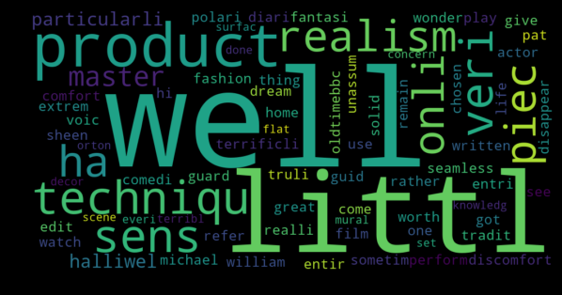
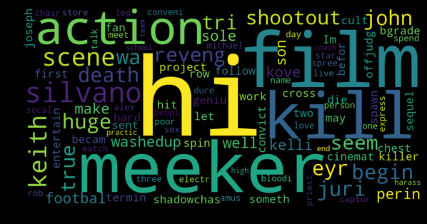
WORDCLOUD FOR WORDS USED IN POSITIVE
AND NEGATIVE REVIEWS:
POSITIVE REVIEW WORDS:
NEGATIVE REVIEW WORDS:
Notes:
an image composed of words used in a particular text or subject, in which the size of each word indicates its frequency or importance.
So, the more often a specific word appears in your text, the bigger and bolder it appears in your word cloud.

